Slide 1
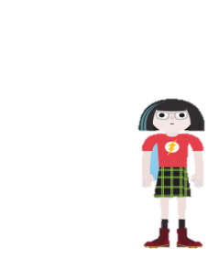
Welcome Best of South-East

Slide 2
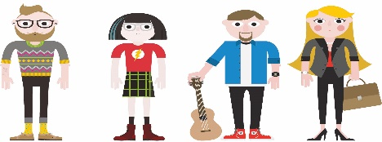
Our Partners
2008-2021
2008
University of Graz
2009
University of Music and Performing Arts Graz
2013
Graz University of Technology
2017
Montanuniversität Leoben

Slide 3
Graduates 2008-2021

Slide 4
Graduates per Country

Slide 5
Gender

Slide 6
#glaubandich
#bestofsoutheast
#getthechance
#bepartofit
#thefutureisyours

Slide 7
#bestofsoutheast

